Slide 1
UAMV

Slide 2
UAMV - Agenda
Principle of operation & integration w/ UAM
Technical system overview
Features & UI vs. previous UAMV
Installation & packing list
Preventive maintenance
Review history of service cases & SW
Suggested practicals (to be done afterward)
Questions/comments/feedback

Slide 3
UAMV – Principle of Operation
The UAMV sits after the back bar, it creates negative pressure to draw fresh gas over the vaporizers and delivers positive pressure to the patient
Old UAMV was bellows-based
During exhalation, bellows rise to draw in fresh gas
During inhalation, bellows descend to deliver ventilation
New UAMV is turbine-based
During inhalation, turbine draws in fresh gas and delivers ventilation

Slide 4
UAMV – Integration with UAM
Old UAMV was in
parallel with manual bellows
New UAMV is in
series before manual bellows
Bellows
UAMV
Bellows
Back bar
Breathing block
Back bar
UAMV
Breathing block

Slide 5
UAMV – Integration with UAM
From back bar
Flex hose connector
UAMV manifold inlet
UAMV inlet
Breathing block
UAMV manifold outlet
UAMV outlet
To patient
Note: If the UAMV is removed, a tube must be put in place between the UAMV manifold inlet & outlet to avoid a leak

Slide 6
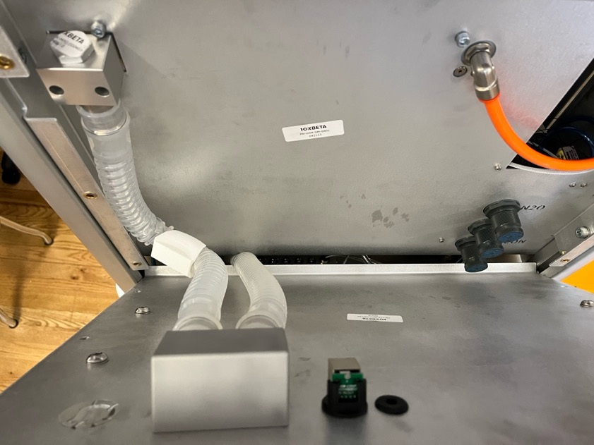
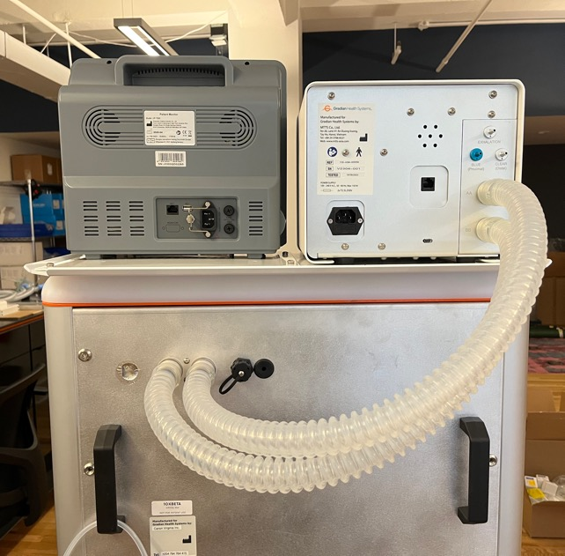
UAMV – Integration with UAM
Back bar → UAMV → Breathing block

Slide 7
UAMV – Features & UI vs. Old UAMV
UI kept largely to same to reduce training changes
Additional Features
Integrated O2 analysis & solenoid control
Li-ion batteries
Modes & parameters (PEEP, loops, R, C, etc.)
Service utilities

Slide 8
UAMV – Features & UI vs. Old UAMV
Sleep mode: Disables knob & touchscreen to avoid turning on during shipping
To enter – 9 short knob presses, then press & hold
To exit – Connect mains power
Hard reset: Power cycles the machine if otherwise unresponsive
5 short knob presses, then press & hold
To exit – Connect mains power

Slide 9
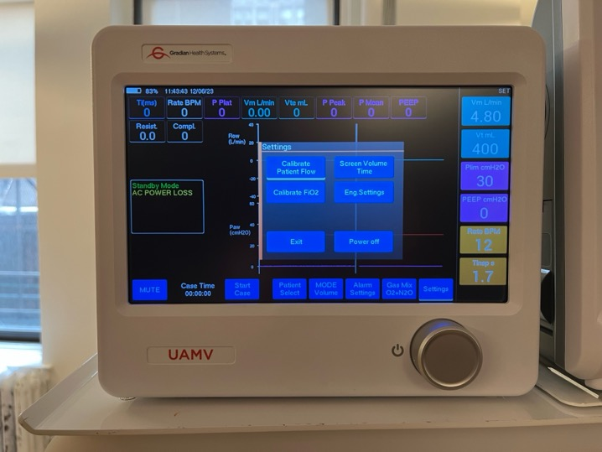
Eng. Settings
Settings -> Eng. Settings -> Service Pin -> 7777
Calibration
Voltages Debug
Error Log
Configuration (FiO2 monitor, buzzer alarm)
Device Stats
Text mode
Knob sequences

Slide 10
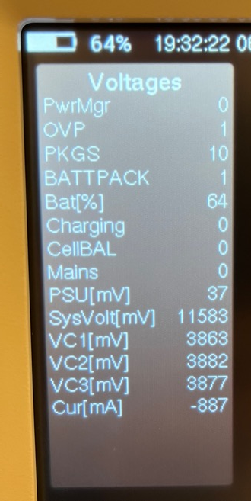
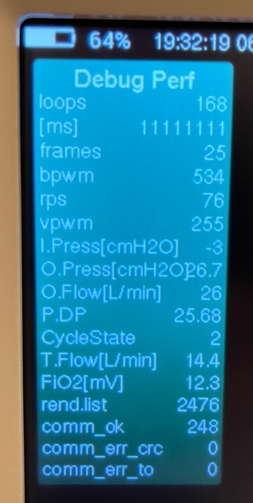
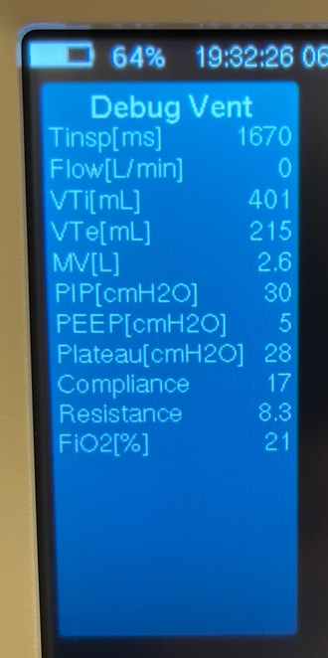
Voltages Debug
Includes multiple pages, click to cycle through

Slide 11
Installation & Packing List
Accessories, parts packing
Installing a UAMV on CVI UAMs
Installing a UAMV on OES UAMs (retrofits)

Slide 12
Installation – UAMV Accessories
UAMV Accessories – packed with UAMV
Part | Qty | P/n | Purpose
Valve drive line adapter | 1 | 1146 | Connect UAMV to breathing block port
Valve drive line (1.5m) | 1 | 1216 | Connect UAMV to breathing block port
Flow sensor | 2 | 1532 | Measure patient airway flow & pressure

Slide 13
Installation – UAMV Accessories
UAMV Accessories Kit – packed with UAM
Part | Qty | P/n | Purpose
Power cord (Type G) | 1 | GRN-PEP-100041 | Connect UAMV to UAM auxiliary AC power socket
UAMV Breathing block port w/ o-ring | 1 | GRN-ASM-100078 | Connect drive valve line adapter to UAM breathing block
Inlet/outlet tube | 2 | GRN-PMP-100039 | Connect UAMV inlet/outlet to UAMV manifold
Ethernet cord | 1 | GRN-PEP-100042 | Connect UAMV to nitrous cut-off solenoid
Ethernet cord clip | 1 | GRN-PMP-100040 | Provide strain relief for cut-off solenoid cord
Fuse 2.5 Amp 250V | 2 | GRN-PEP-100043 | Spares, in case inlet fuses burn

Slide 14
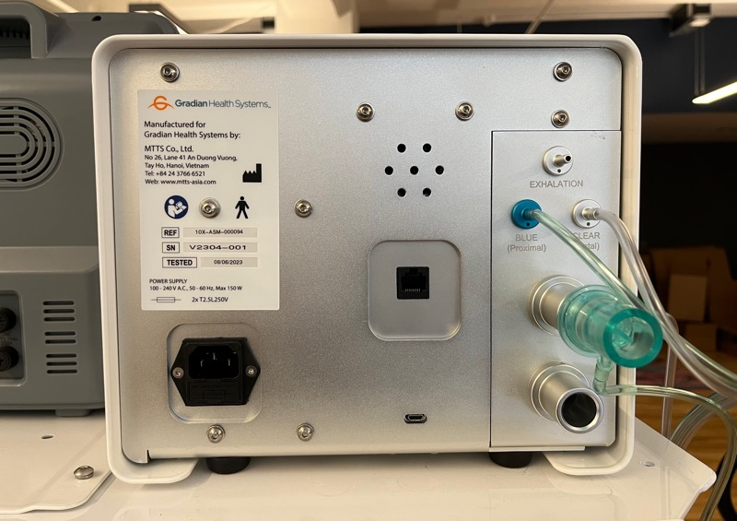
Installation (Canon UAM)
Turn on UAMV
Confirm SW version
Confirm O2 analysis is correct
Zero offsets
Calibrate Patient Flow
Connect:
UAM inlet/outlet tubes
Valve drive line
Solenoid cable
Flow sensor

Slide 15
Installation – Retrofit (OES UAM)
Goals
Replicate UAMV manifold
Connect backbar to UAMV manifold
Connect valve drive line to breathing block
Parts
UAMV Accessories Kit – Provide connections for UAM
Rear Plate or Hatch – Create openings for UAMV manifold
Kit A – Replicate UAMV manifold
Kit B – Connect valve drive line adapter to old breathing block port

Slide 16
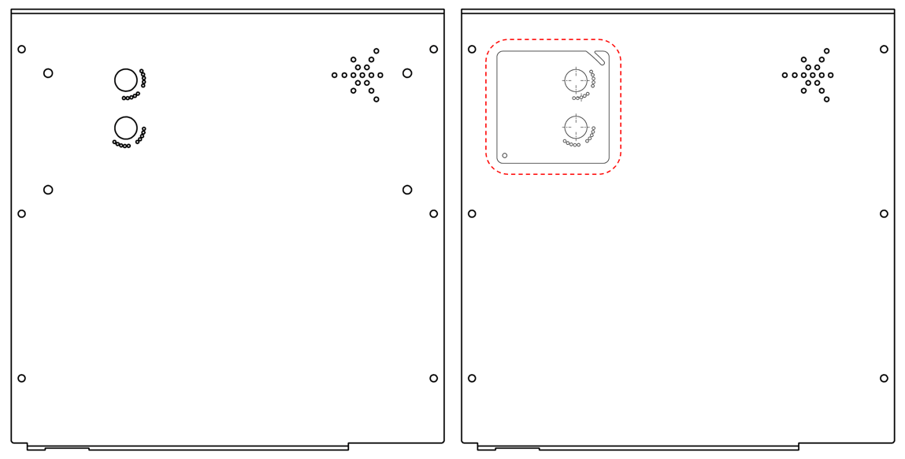
Installation – Retrofit (Rear Hatch & Plate)
Rear Hatch & Plate – Create openings for UAMV manifold
UAMV retrofit rear plate (GRN-MFG-100021)
UAMV retrofit rear hatch (GRN-MFG-100020)

Slide 17
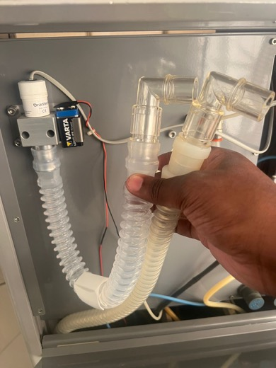
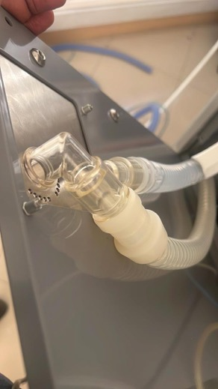
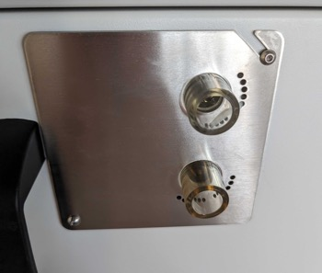
Installation – Retrofit (Kit A)
Kit A – Replicate UAMV Manifold
Parts
Qty 2 of Breathing circuit elbow connector (GRN-PMP-100163)
Qty 2 of Breathing circuit straight connector (GRN-PMP-100164)
Qty 1 of Breathing circuit (short) (GRN-PMP-100162)
Qty 1 of Tube anti-kink clip (GRN-MFG-100001)
Qty 4 of Cable tie, narrow, 8" long (GRN-PMP-100207)
Procedure
Assemble connectors to make elbows
Attach one elbow to the hose going to the breathing block
Attach breathing circuit between backbar and one elbow
Attach anti-kink clip to avoid bends in the breathing circuit
Place elbows through holes in retrofit plate/hatch
Use cable ties to hold elbows in place
Ensure there are no kinks or twists

Slide 18
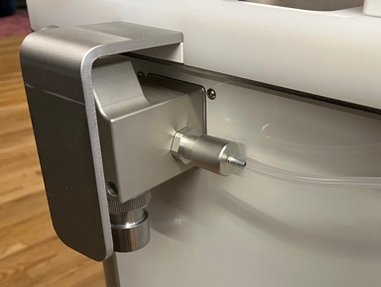
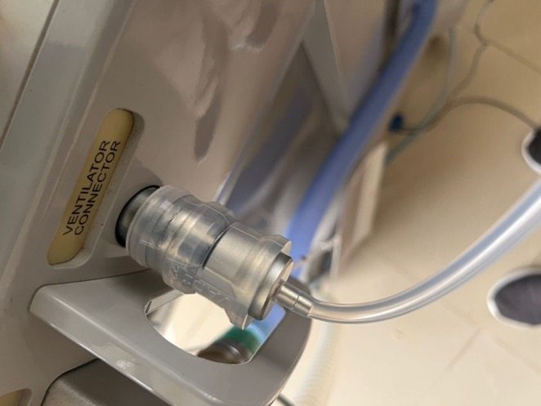
Installation – Retrofit (Kit B)
Kit B – Connect valve drive line to breathing block
Parts
Qty 1 Breathing circuit elbow connector (GRN-PMP-100163)
Qty 1 Reusable straight connector, 22mm ID x 5cm (GRN-PMP-100206)
Procedure
Insert the valve drive line adapter into the straight connector
Attach the elbow connector to the UAMV port in the breathing block
Attach the straight connector to the elbow connector
New-style breathing block (reference)
Old-style breathing block

Slide 19
Installation – Retrofit (Identifying Parts)
Is the UAM serial number after 2304-008?
If YES, no retrofit parts are required
Is the UAM serial number between A2302-001 and A2304-008?
If YES, contact the Product team for additional information
Is the UAM serial number before 2302-001?
If YES, add UAMV Accessory Kit (GRN-ASM-100074)
If YES, add UAMV retrofit Kit A (GRN-ASM-100073)
Is the UAM serial number before 21810-001?
If YES, add UAMV retrofit Kit B (GRN-ASM-100072)
Is the UAM serial number before 21712-001?
If YES, add UAMV retrofit rear plate (GRN-MFG-100021)
if NO, add UAMV retrofit rear hatch (GRN-MFG-100020)
Is this the first time any UAMV has been installed on the UAM?
If YES, confirm that the breathing block has a port for a Vent connector (OES p/n 2150-056)
If YES, confirm whether a Vent connector is needed
Notes:
ADD FIRST CVI RUN

Slide 20
Technical System Overview
Functional operation
Sub-assembly layout & serviceability
Component review
Discussion of benefits/drawbacks vs. previous design

Slide 21
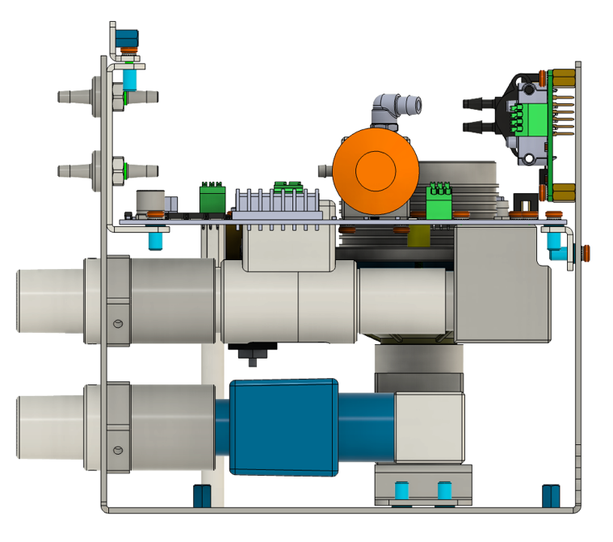
Functional Operation
Pressure
sensors
Pneumatic components
Turbine generates flow
Inlet check valve prevents backflow
Sensors
Pressure sensor (ambient)
Pressure sensor (outlet)
Pressure sensor (airway)
Vent flow sensor
Pt flow sensor (pressure)
O2
sensor
Flow
sensor
Outlet
Inlet w/ check valve
Filter

Slide 22
Functional Operation
Turbine
Inlet
Filter
V Flow Sensor
Outlet
Reservoir
Turbine Seal
Valve
O2
Sensor
Fenton
Balloon

Slide 23
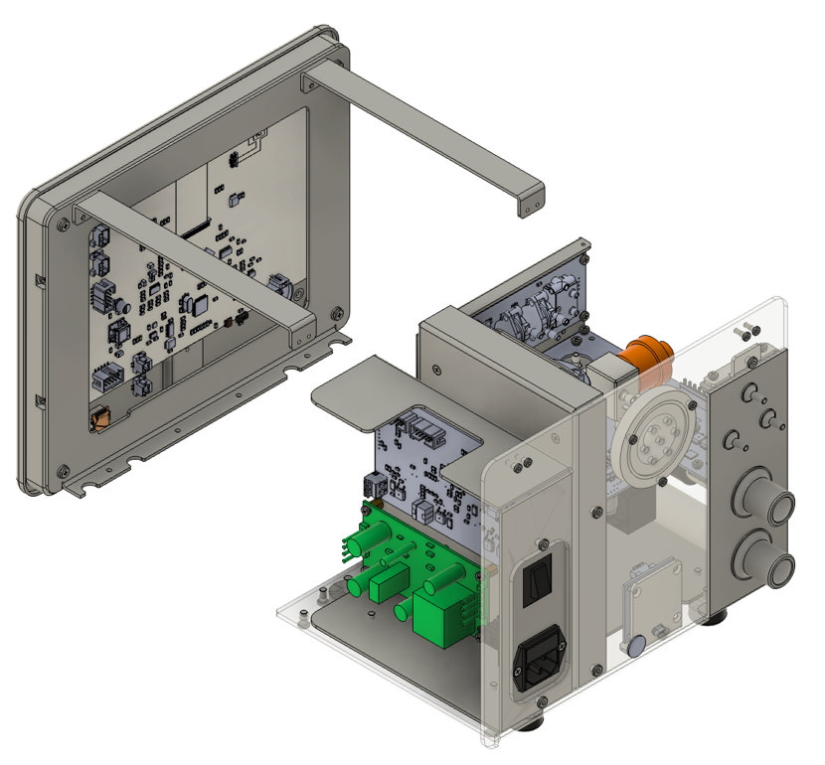
Technical System Overview - Electronics
Boards
Main display
Pneumatic control
Sensor board
Power management
Battery pack
USB interface
Connections
Mains power
Micro USB
Solenoid (ethernet)
Benefits
All sensors on one board
USB connection to any board

Slide 24
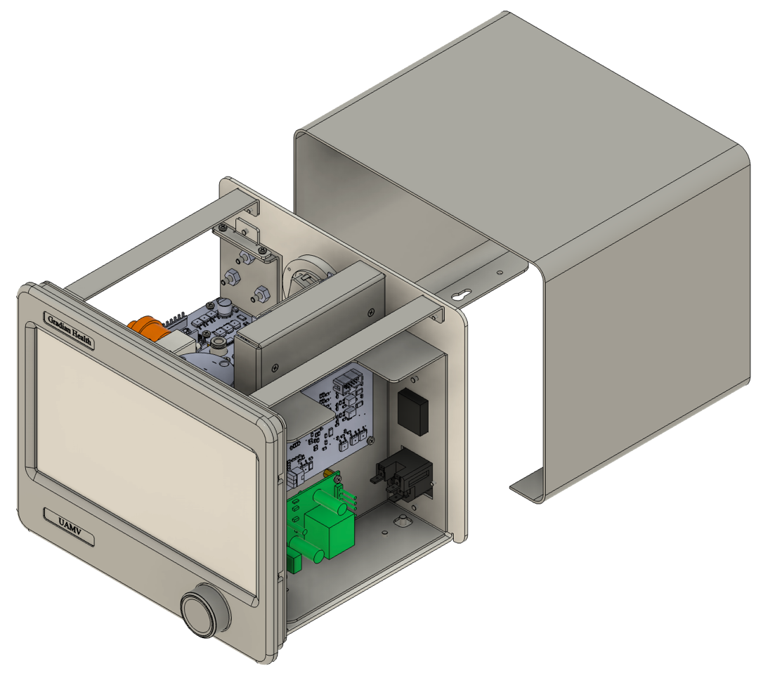
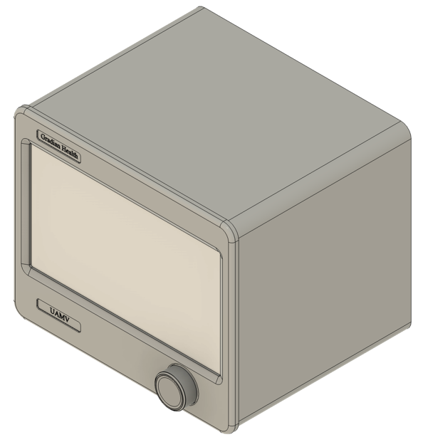
Casing
4 screws, removes from rear

Slide 25
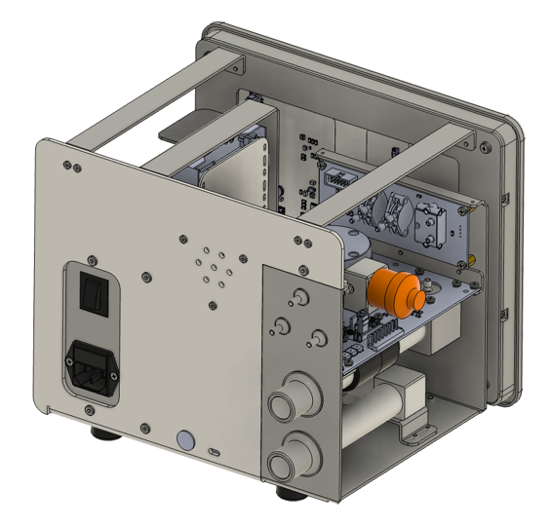
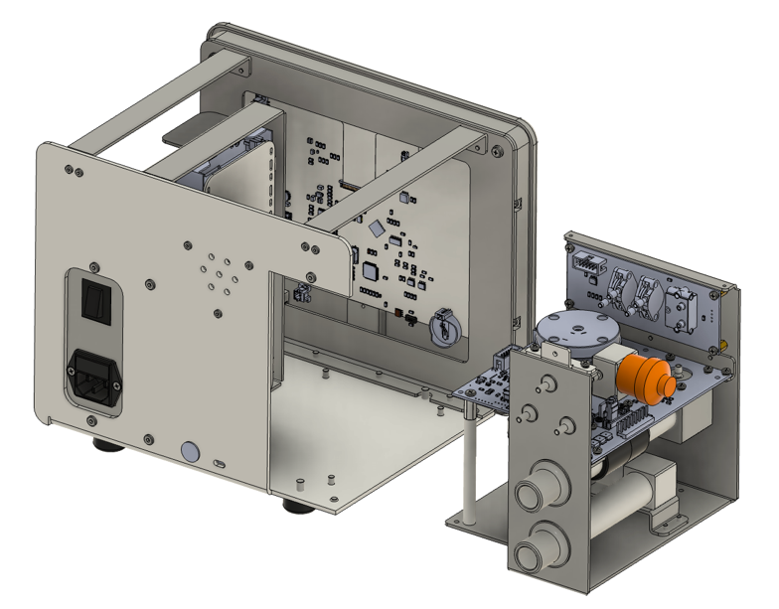
Pneumatic Module
Contains all sensors, pneumatic components

Slide 26
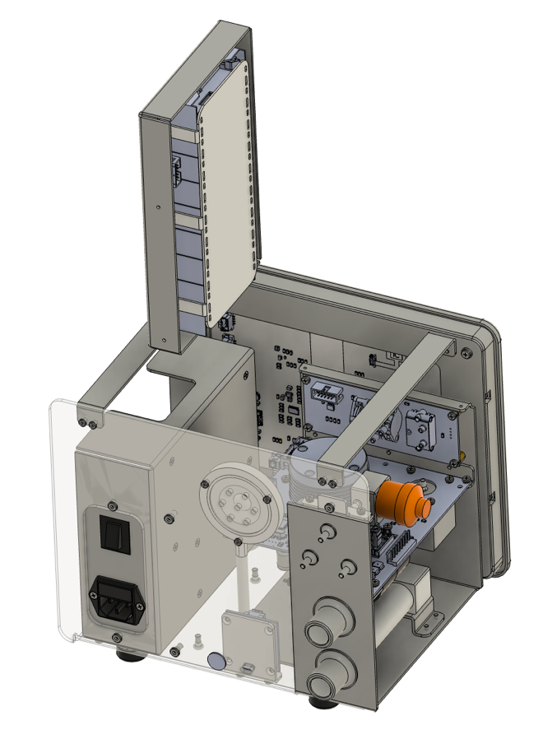
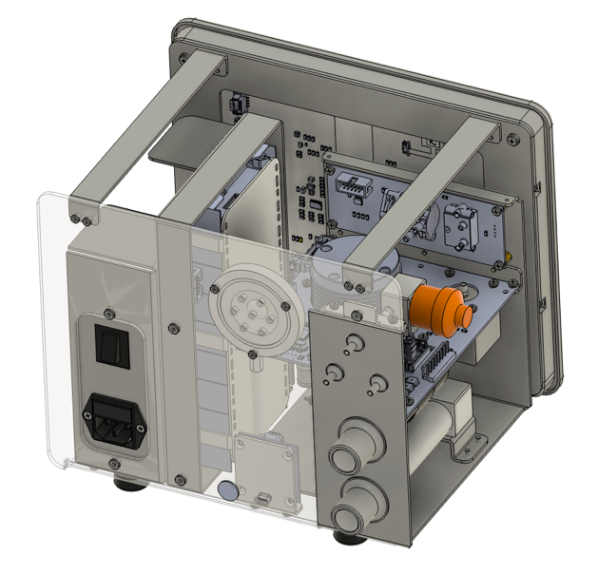
Battery Module
Contains cells, management board

Slide 27
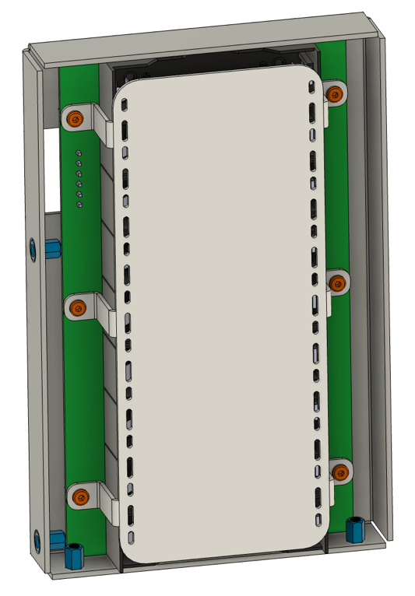
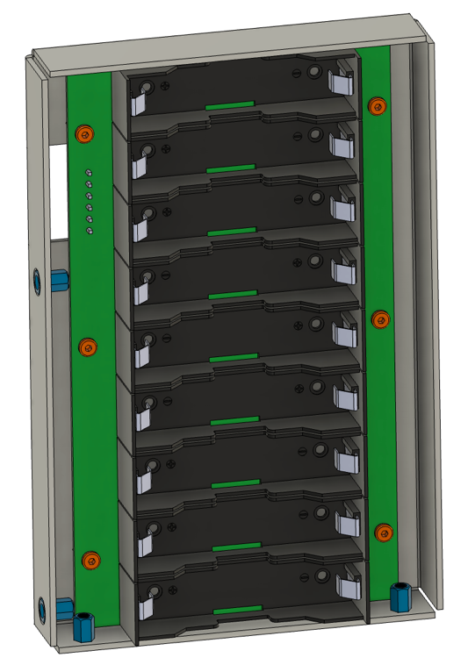
Battery Module

Slide 28
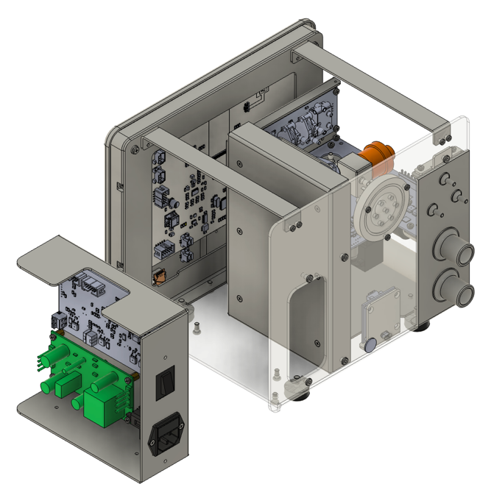
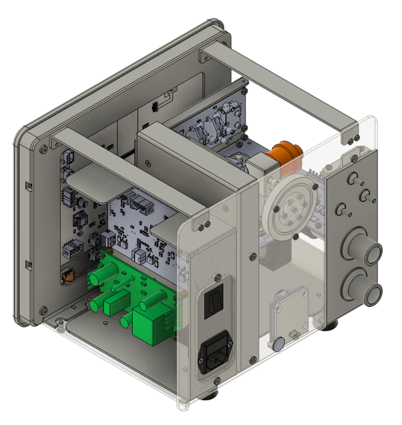
Power Module
Contains transformer, power board

Slide 29
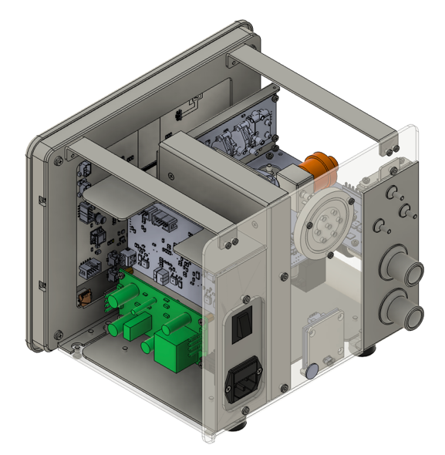
Display Module
Contains screen, driver

Slide 30
Benefits & Drawbacks of New Design
Benefits
Integrated O2 analysis, consolidates electronics
Allows for setting PEEP
Increased serviceability
Lower cost
Drawbacks
Adds minimal resistance to draw-over
Additional potential for leak
Less easily understood

Slide 31
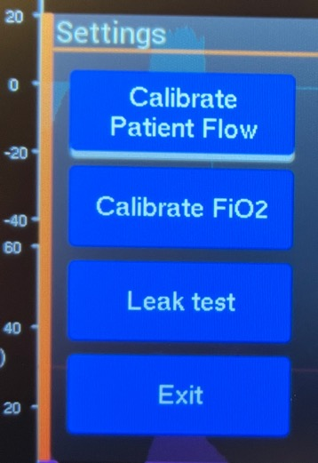
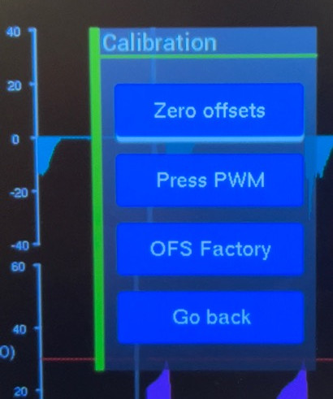
UAMV Preventive Maintenance
User Calibrations
Eng. Calibrations

Slide 32

UAMV Preventive Maintenance
Consumables
MOX-3 O2 sensor
Inlet filter
Required equipment & tools
Hex wrenches
SW upgrade procedure
Batteries
Lithium ion cells
Confirm orientation

Slide 33
Software History Review
Software should always be updated during PMs, if not more urgent
Version 1.04
Display: changed timing settings to address white screen problem
Fenton valve leak test: added filter to reduce low flow noise, Pass threshold: <= 0.3 LPM
GUI: added hours of use counter to Device Stats Window
Pneumatic module: reduced motor block detection time to 50ms
Real Time Clock: Add a bit mask to remove the leap year flag from month data byte
Version 1.03
Version increase to resolve possible confusion between GUI-programmer (MacOS) and terminal programmer (all OS) experienced on 30/11/2023 during troubleshooting in Madagascar)
Version 1.02
Power off via push & hold knob for 3 seconds
Leak test (pass/fail) in user calibration menu
Changed dialog title from “Inspiratory time settings” to “Inspiratory time”
Version 1.01
Added power on beep as “audible” feedback
Added startup delay to handle white screen problem
Changed flow control to be based on patient flow sensor

Slide 34
UAMV Cases – Fenton Balloon
Symptom: UAMV provides increasingly large Vt, eventually resets
Cause:
Fenton balloon is providing an incomplete seal
Incomplete seal causes gas to leak out during inspiration
UAMV attempts to compensate for leak by increasing flow
Eventually, turbine exceeds maximum power draw and resets
Fix:
All units are tested for Fenton balloon location at the factory
UAMV software updated to prevent overcompensation and resetting

Slide 35
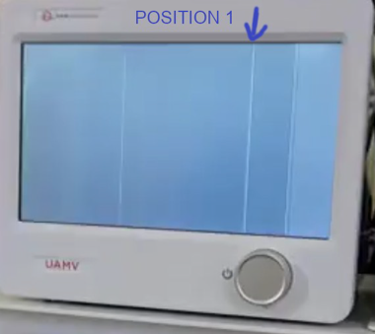
UAMV Cases – White Screen
Symptom: During normal operation, screen goes white
Cause:
Display controller does not complete frame on time, LCD panel is out of sync, LCD panel power supply shuts down
Fix:
UAMV software updated to prevent issue, starting with v1.04

Slide 36
UAMV Cases – Pneumatic Module Reset
Symptom: During normal operation, ventilator resets continuously
Cause:
TBD, troubleshooting in progress
Fix:
Disconnecting or replacing the pneumatic module resolves the behavior

Slide 37
Suggested Practicals
Installation procedure (CVI UAM)
Installation procedure (all retrofit combinations)
Follow tubing & wires, identify components
Remove & replace each module
Replace battery cells

Slide 38
Questions / Comments / Feedback

